Slide 1
Computer Vision: Looking Back to Look Forward
image source
Svetlana Lazebnik
IRIM Short Course
Spring 2020

Slide 2
Outline of lectures
Tues. 1/28: Where are we going, where have we been?
Wed. 1/29: Stepping back: What is the nature of visual perception?
Thurs. 1/30: History of ideas in recognition – Part I
Tues. 2/4: History of ideas in recognition – Part II
Wed. 2/5: Emerging trends – or, what should we be working on?
Thurs. 2/6: Ethical issues for computer vision researchers

Slide 3
Ethics in computer vision: Outline
Face recognition
Dataset and model bias
Image manipulation
Computer vision for global challenges
Carbon footprint
AI hype
Ethical best practices

Slide 4
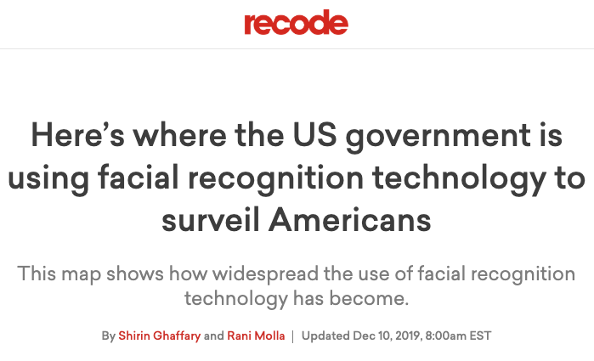
Concerns about face recognition
https://www.vox.com/recode/2019/7/18/20698307/facial-recognition-technology-us-government-fight-for-the-future

Slide 5
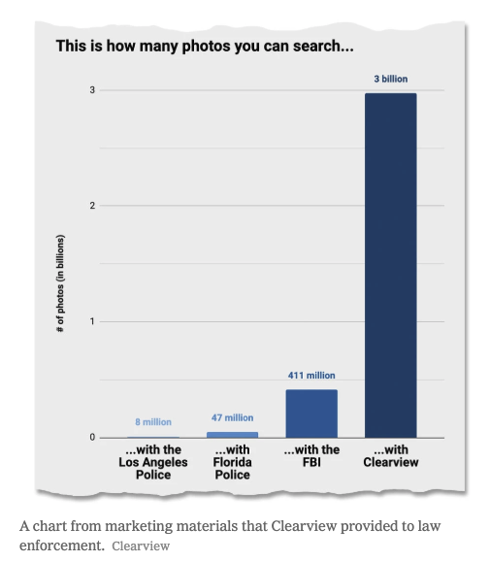

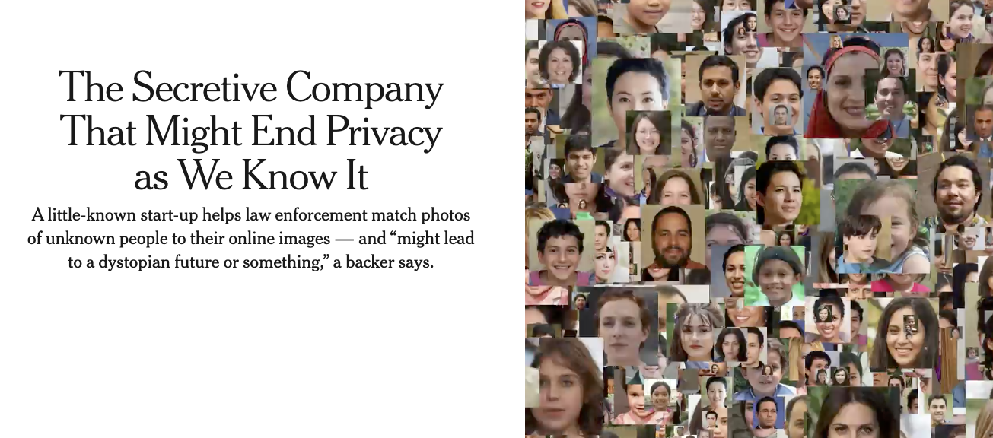
Fears of universal mass surveillance (and dubious claims)
https://www.nytimes.com/2020/01/18/technology/clearview-privacy-facial-recognition.html
https://www.buzzfeednews.com/article/ryanmac/clearview-ai-nypd-facial-recognition

Slide 6
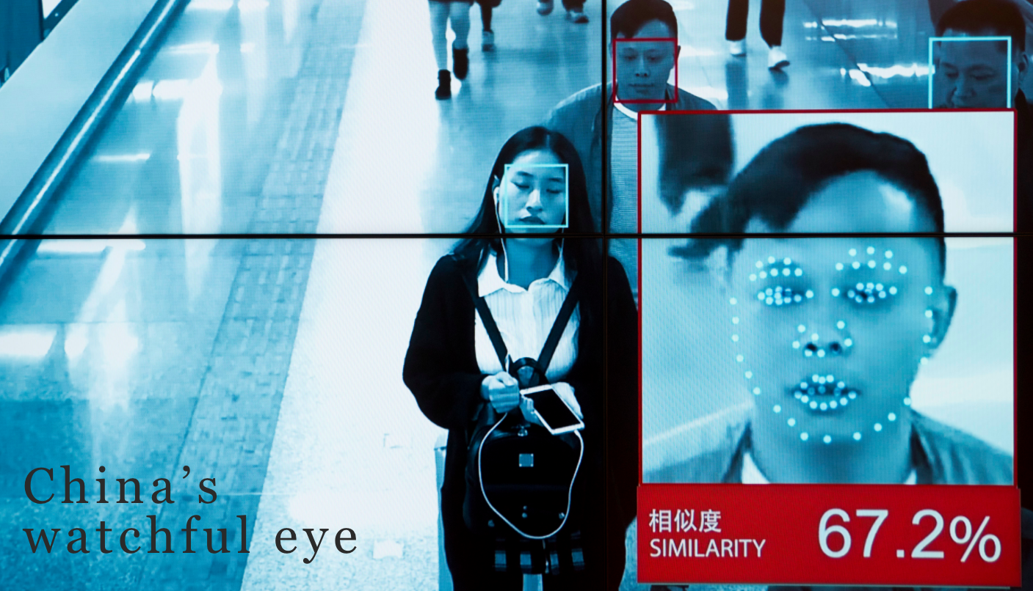
Face recognition in China
Beijing bets on facial recognition in a big drive for total surveillance – Washington Post, 1/8/2018

Slide 7
Face recognition in China
How China Uses High-Tech Surveillance to Subdue Minorities – New York Times, 5/22/2019
One Month, 500,000 Face Scans: How China Is Using A.I. to Profile a Minority – New York Times, 4/14/2019
China Uses DNA to Map Faces, With Help From the West – New York Times, 12/3/2019

Slide 8
Face recognition in China
A truly dystopian use case…
China City Uses Facial Recognition to Shame Pajama Wearers – New York Times, 1/21/2020

Slide 9
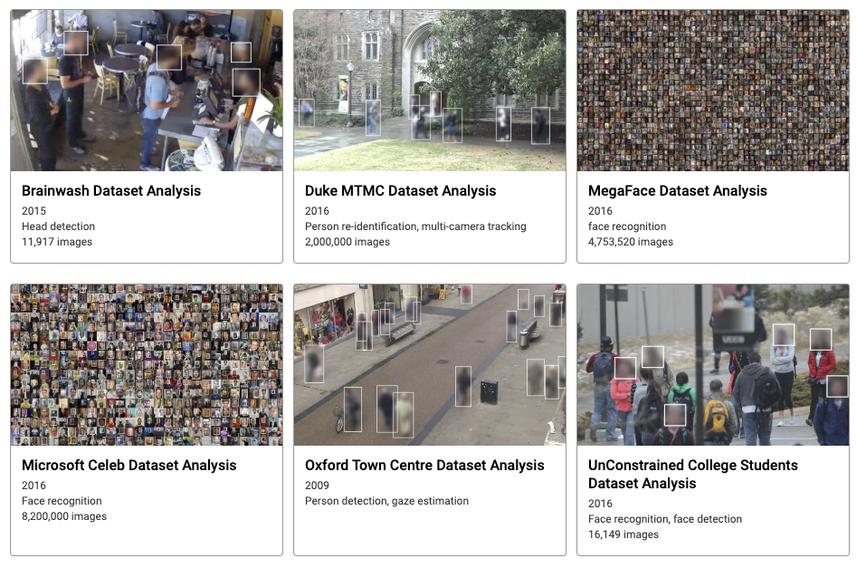
Datasets: Privacy, consent issues
https://megapixels.cc/
https://www.ft.com/content/cf19b956-60a2-11e9-b285-3acd5d43599e
See also: https://www.theregister.co.uk/2020/01/27/ibms_facial_recognition_software_gets_it_in_trouble_again/

Slide 10
More reading
https://www.wired.com/story/secret-history-facial-recognition/
https://www.newyorker.com/magazine/2018/12/17/should-we-be-worried-about-computerized-facial-recognition
https://www.washingtonpost.com/technology/2019/07/07/fbi-ice-find-state-drivers-license-photos-are-gold-mine-facial-recognition-searches/
https://www.nytimes.com/2019/08/01/nyregion/nypd-facial-recognition-children-teenagers.html

Slide 11
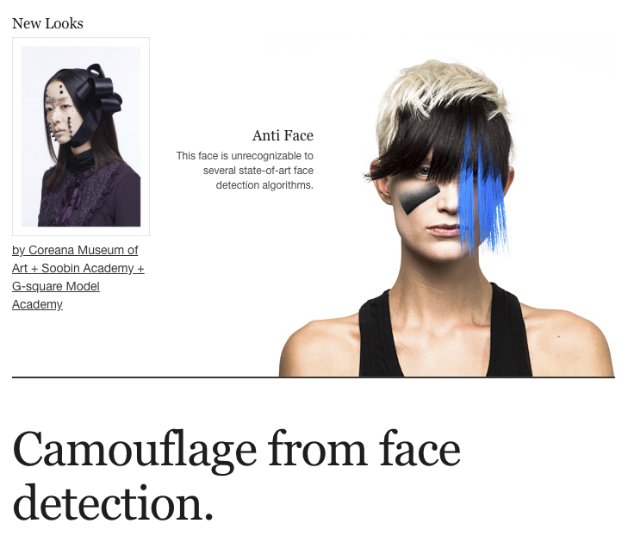
Face recognition: Discussion
Summary of concerns
Unethical use and misuse
Unequal impact: technology may not work equally well for everybody
Ethics of data collection: privacy, consent
Possible solutions
Regulation
Auditing
Resistance?
https://cvdazzle.com/

Slide 12

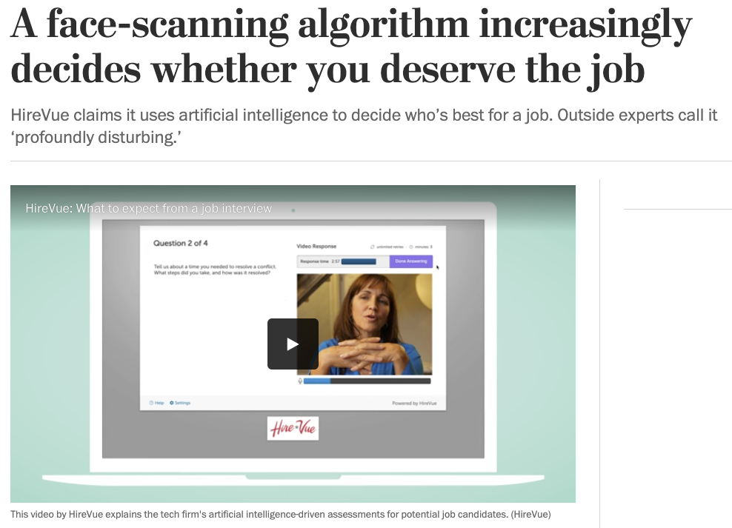
Other potentially sensitive research topics
Face analysis for inferring internal states or personal characteristics
See discussion of emotional privacy issues
https://www.washingtonpost.com/technology/2019/10/22/ai-hiring-face-scanning-algorithm-increasingly-decides-whether-you-deserve-job/

Slide 13
Other potentially sensitive research topics
Face analysis for inferring internal states or personal characteristics
Person and vehicle re-identification (esp. in challenging conditions, e.g., behind glass, in low light, under heavy occlusion, etc.)
Activity monitoring
Lip reading from video
Recovery of audio from video (e.g., from vibration)
Non-line-of-sight and through-the-wall imaging

Slide 14
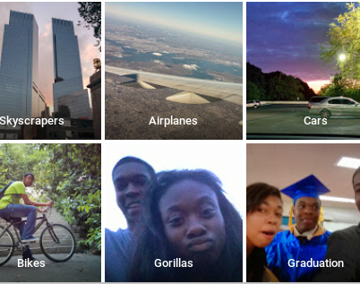
Biased recognition algorithms
https://bits.blogs.nytimes.com/2015/07/01/google-photos-mistakenly-labels-black-people-gorillas/

Slide 15
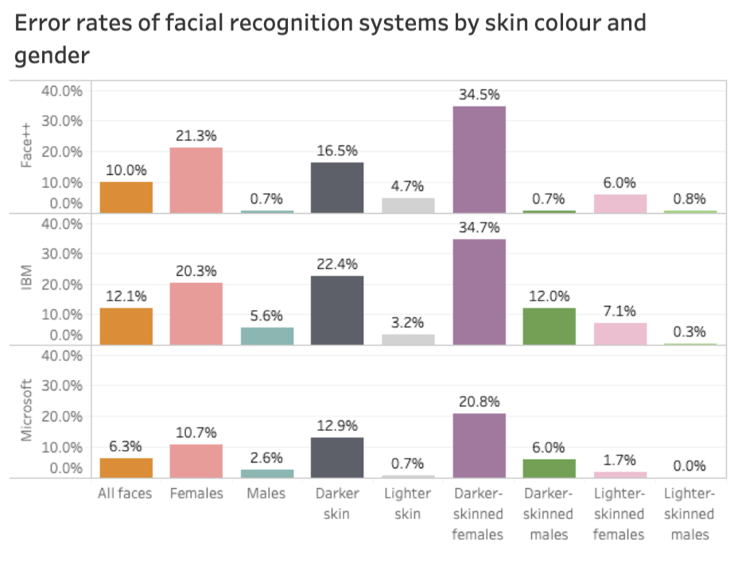
Bias in face recognition
Figure source
J. Buolamwini and T. Gebru, Gender Shades: Intersectional Accuracy Disparities in Commercial Gender Classification, Proceedings of the 1st Conference on Fairness, Accountability and Transparency, 2018

Slide 16
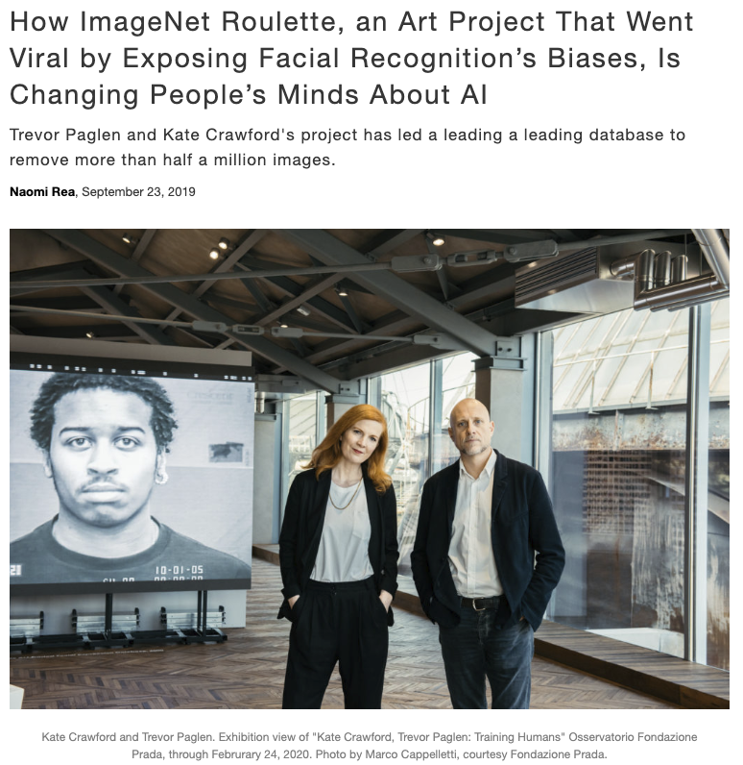
Bias in ImageNet
Source
K. Crawford and T. Paglen, Excavating AI: The Politics of Training Sets for Machine Learning (September 19, 2019) https://excavating.ai

Slide 17
Bias in ImageNet
K. Crawford and T. Paglen, Excavating AI: The Politics of Training Sets for Machine Learning (September 19, 2019) https://excavating.ai

Slide 18
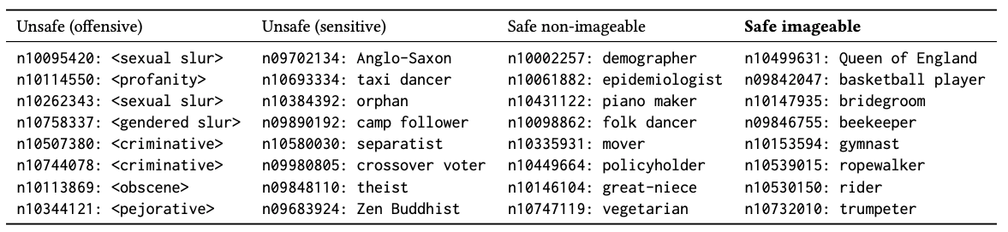
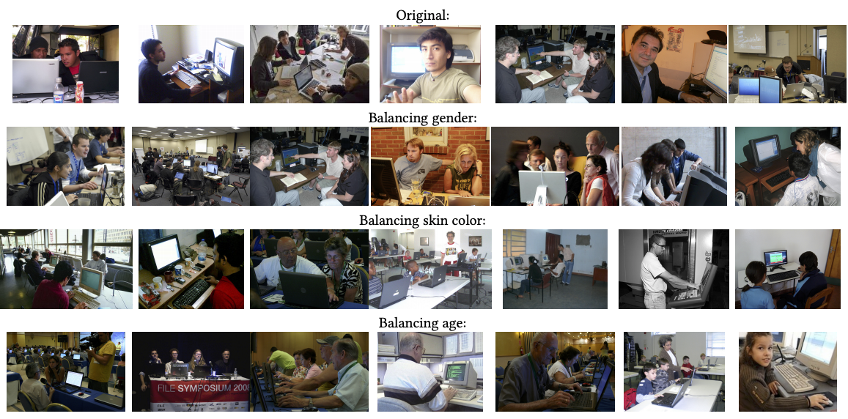
Bias in ImageNet
“Programmer”
K. Yang, K. Qinami, L. Fei-Fei, J. Deng, O. Russakovsky, Towards Fairer Datasets: Filtering and Balancing the Distribution of the People Subtree in the ImageNet Hierarchy, Conference on Fairness, Accountability, and Transparency (FAT*), 2020

Slide 19
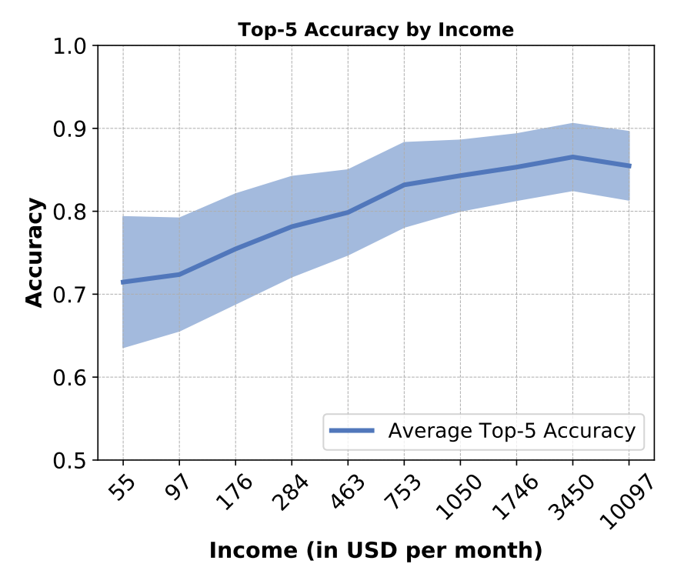
Geographical bias in object recognition
T. DeVries, I. Misra, C. Wang, L. van der Maaten, Does Object Recognition Work for Everyone? Workshop on Computer Vision for Global Challenges at CVPR 2019
https://ai.facebook.com/blog/new-way-to-assess-ai-bias-in-object-recognition-systems

Slide 20
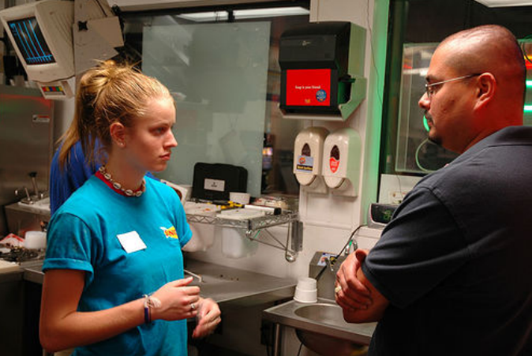
Bias in image captioning datasets
A blond girl and a bald man with his arms crossed are standing inside looking at each other.
A worker is being scolded by her boss in a stern lecture.
A manager talks to an employee about job performance.
A hot, blond girl getting criticized by her boss.
Sonic employees talking about work.
E. van Miltenburg, Stereotyping and Bias in the Flickr30K Dataset, Proceedings of the Workshop on Multimodal Corpora: Computer vision and language, collocated with LREC 2016

Slide 21
Bias: Discussion
Summary of concerns
Output of trained systems ends up echoing societal biases due to biased problem formulation, algorithms, model structure, or all of the above
Possible solutions
Dataset collection standards, model reporting
See, e.g., Jo & Gebru (2019), Mitchell et al. (2019)
Internal and external auditing
See, e.g., Raji et al. (2020)
Develop techniques for reducing bias

Slide 22
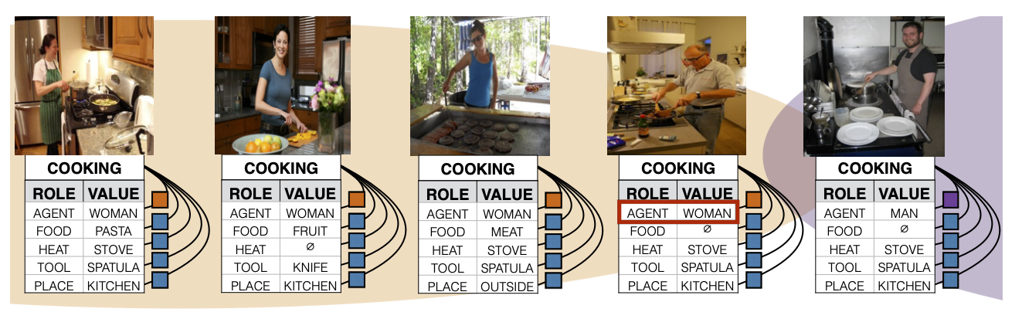
Bias reduction techniques
J. Zhao, T. Wang, M. Yatskar, V. Ordonez, K.-W. Chang, Men also like shopping: Reducing Gender Bias Amplification using Corpus-level constraints, EMNLP 2017

Slide 23
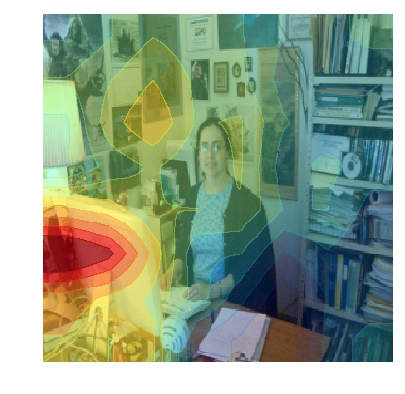
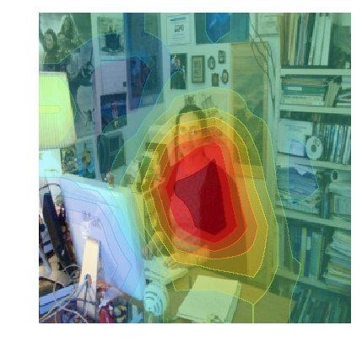
Bias reduction techniques
Baseline: A man sitting at a desk with a laptop computer.
Improved model: A woman sitting in front of a laptop computer.
L. Hendricks, K. Burns, K. Saenko, T. Darrell, A. Rohrbach, Women Also Snowboard: Overcoming Bias in Captioning Models, ECCV 2018

Slide 24
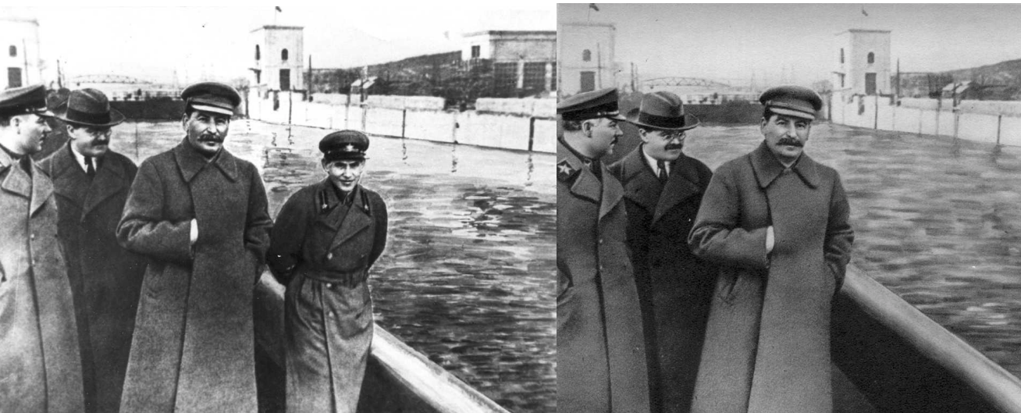
Ethics and photo manipulation
D. King, The Commissar Vanishes: The Falsification of Photographs and Art in Stalin's Russia, 1997
Frédo Durand, Ethics and Computational Photography, 2019

Slide 25

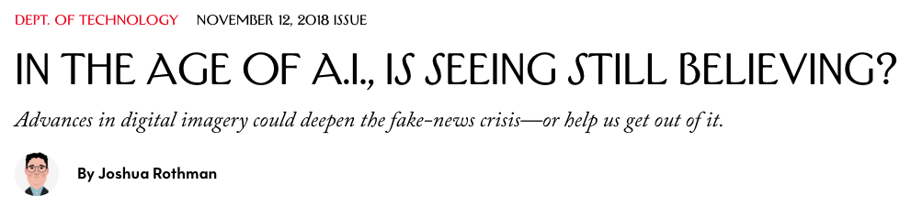
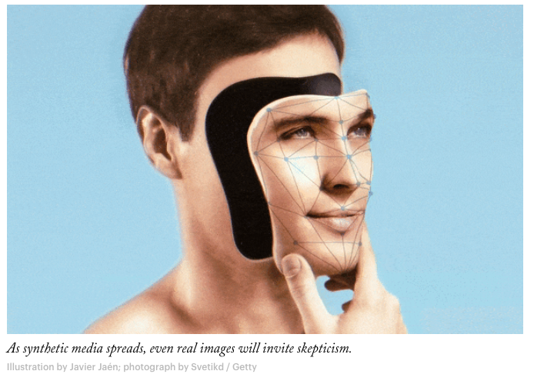
DeepFakes
https://www.newyorker.com/magazine/2018/11/12/in-the-age-of-ai-is-seeing-still-believing

Slide 26
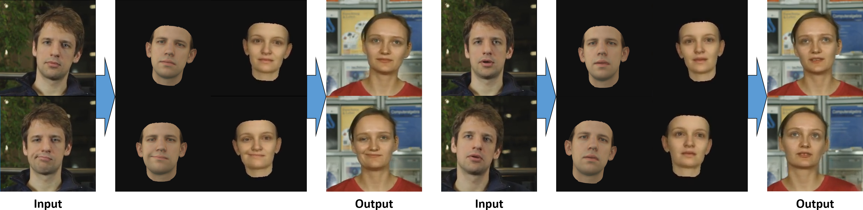
DeepFakes
Example system: H. Kim et al., Deep video portraits, SIGGRAPH 2018
Jordan Peele as Obama video
Time to panic?
“A quiet wager has taken hold among researchers who study artificial intelligence techniques and the societal impacts of such technologies. They’re betting whether or not someone will create a so-called Deepfake video about a political candidate that receives more than 2 million views before getting debunked by the end of 2018” – IEEE Spectrum, May 2018
Panic is unjustified? – The Verge, March 2019

Slide 27
DeepFakes: Discussion
Summary of concerns
“DeepFake” technology has drastically lowered costs and barriers to entry for sophisticated photo and video manipulation
Manipulation for political ends causes the most alarm, although harassment and objectification of women may be most common use cases in practice
There are also concerns about this technology revolutionizing the entertainment industry (e.g., putting dead actors in movies)
Possible solutions
Codes of ethics, standards (already exist in photojournalism)
Regulation (including self-regulation by social media companies)
Techniques for spotting manipulated content
For detailed discussion and examples, see Frédo Durand, Ethics and Computational Photography, 2019

Slide 28

Computer vision for global challenges
Sample of presentation titles:
Predicting deforestation and detecting illegal logging with CV in Chile
A Dataset for Assessing Building Damage from Satellite Imagery
Deep Landscape Features for Improving Vector-borne Disease Prediction
Infant-Prints: Fingerprints for Reducing Infant Mortality
Towards Detecting Dyslexia in Handwriting Using Neural Networks
Intelligent Crop Health and Pest Detection
A rapid malaria diagnosis test using a mobile phone
Eliminating Bonded Labour in Brick Kilns of South Asia
Poverty Prediction Using Satellite Imagery
Computer Vision for Drought Resilience
https://www.cv4gc.org/#program

Slide 29
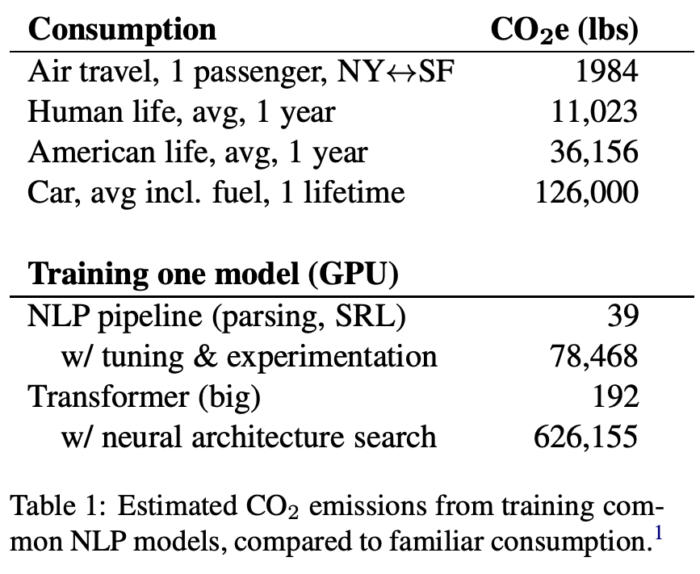
Carbon footprint of deep learning
E. Strubell, A. Ganesh, A. McCallum, Energy and Policy Considerations for Deep Learning in NLP, arXiv:1906.02243, 2019

Slide 30
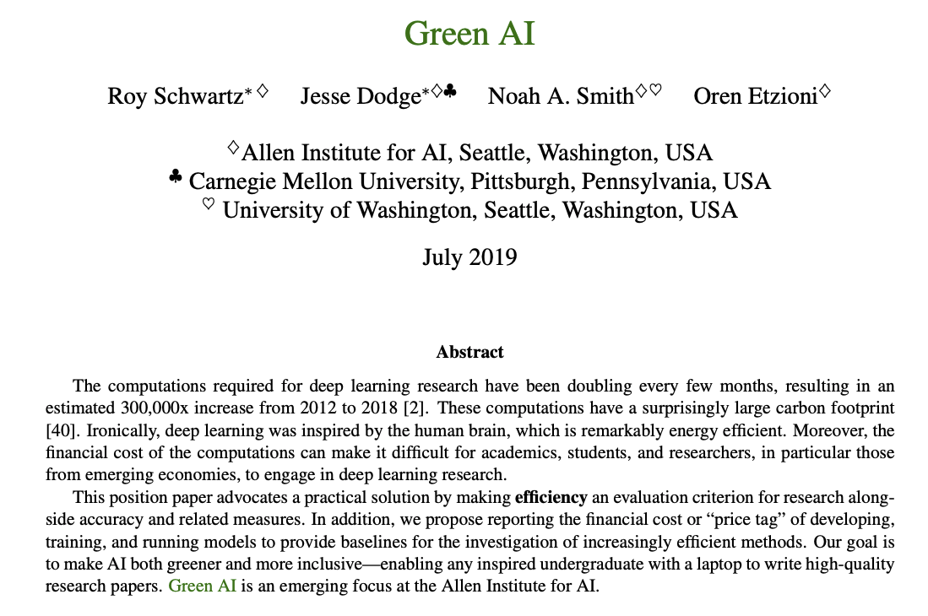
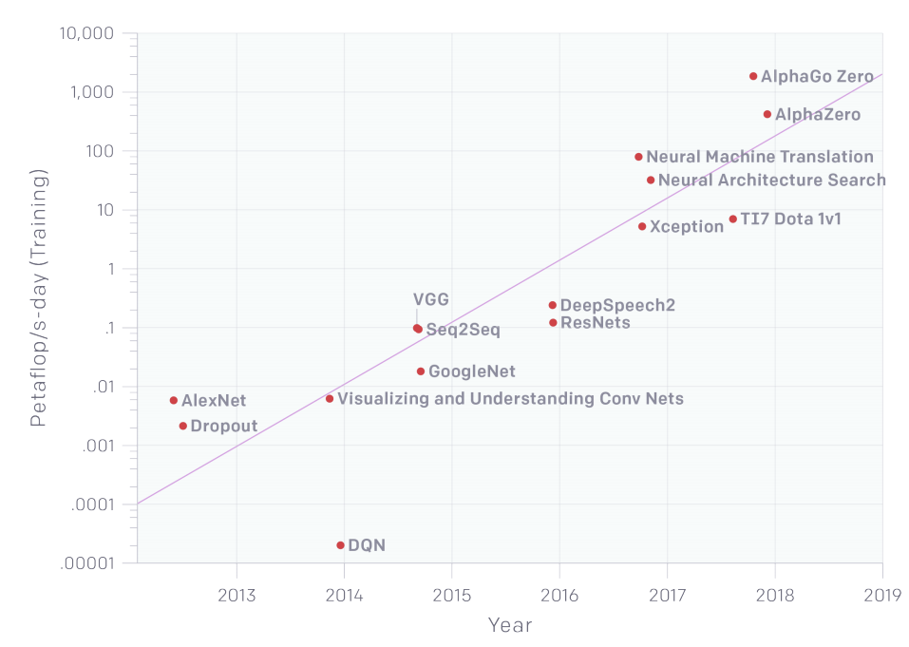
Towards Green AI?
https://openai.com/blog/ai-and-compute/
https://arxiv.org/pdf/1907.10597v3.pdf

Slide 31
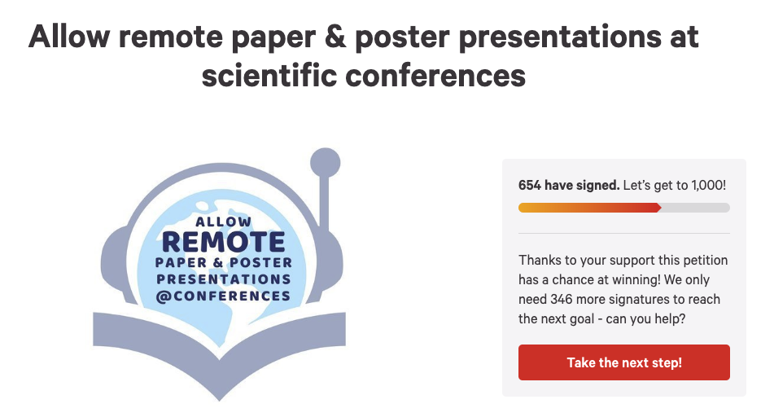
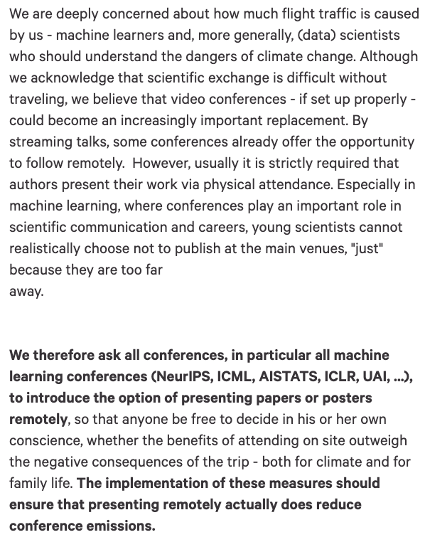
Just today…
Change.org petition

Slide 32
AI hype
https://thegradient.pub/an-epidemic-of-ai-misinformation/
Summary of concerns:
Hype can corrupt the peer review process and the culture of the entire field
Can even cause public backlash and withdrawal of funding
Possible solutions:
Conference policies on press and social media
Self-regulation by researchers

Slide 33
Towards ethical best practices
http://ai.stanford.edu/blog/ethical-best-practices/
Concrete recommendations:
Conferences should adopt ethics codes and appoint ethics chairs
Authors should be encouraged to add ethical impacts sections in papers and disclose concerns with released code and data
Authors should be required to disclose funding sources and possible conflicts of interest in papers
Restrict approval and terms of access for sensitive code, datasets, and models
What to do if you are working on a topic that has the potential to be misused?
See GPT-2 controversy
Bottom line: it is time for computer vision researchers to reject the “view from nowhere”
T. Gebru, Chapter on Race and Gender, Oxford Handbook on AI Ethics, 2019

